Slide 1



Crop And Fertilizers Recommendation System using Machine Learning

Slide 2

Learning Objectives
●This project involves developing an advanced system that employs machine learning to analyze soil attributes, weather conditions, and historical data, providing precise crop recommendations for farmers.
● By integrating data-driven insights, the system aims to optimize crop selection and enhance agricultural productivity.
GOAL
Source :
www.freepik.com/

Slide 3
Tools and Technology used
Programming languages: Python is a popular choice due to its rich libraries and frameworks for machine learning. R is also used for statistical computing and data analysis.
Machine learning libraries: Scikit-learn, TensorFlow, and PyTorch are commonly used for building and training machine learning models.
Data collection tools: Sensors, drones, and satellites are used to collect data on soil properties, weather conditions, and crop health.Here we have considered existing data sets.
Data storage and processing: Cloud platforms like AWS, Azure, and Google Cloud are used for storing and processing large datasets.
Visualization tools: Matplotlib and Seaborn are used for visualizing data and model results.
Web frameworks: Flask and Django are used for building web applications for crop and fertilizer recommendations.
Machine learning algorithms: Supervised learning algorithms like decision trees, random forests, and support vector machines are used for predicting crop yields and fertilizer requirements.
Overall, crop and fertilizer recommendation systems using machine learning involve a combination of software and hardware tools for data collection, processing, modeling, and visualization.

Slide 4
Recent
Crop Recommendation Tools
Mathematical Foundations
Medicine Effectiveness Test
An Introduction to Ethics
Ohm's Law in Circuits
More
Gem manager Help
Activity Settings
Try Gemini Advanced
Vijayawada, Andhra Pradesh, India
From your IP address • Update location
Conversation with Gemini
Tools And Technologies used in crop And Fertilizers Recommendation SYSTEM USING Machine Learning
Several tools and technologies are used in crop and fertilizer recommendation systems using machine learning. These include:
Programming languages: Python is a popular choice due to its rich libraries and frameworks for machine learning. R is also used for statistical computing and data analysis.
Machine learning libraries: Scikit-learn, TensorFlow, and PyTorch are commonly used for building and training machine learning models.
Data collection tools: Sensors, drones, and satellites are used to collect data on soil properties, weather conditions, and crop health.
Data storage and processing: Cloud platforms like AWS, Azure, and Google Cloud are used for storing and processing large datasets.
Visualization tools: Matplotlib and Seaborn are used for visualizing data and model results.
Web frameworks: Flask and Django are used for building web applications for crop and fertilizer recommendations.
Some specific technologies used in these systems include:
Machine learning algorithms: Supervised learning algorithms like decision trees, random forests, and support vector machines are used for predicting crop yields and fertilizer requirements.
Deep learning: Deep learning models can be used for more complex tasks like image recognition for crop disease detection.
Geospatial data analysis: Tools like GIS software are used for analyzing spatial data related to soil properties and weather patterns.
Internet of Things (IoT): IoT devices can be used for real-time monitoring of soil and weather conditions.
Overall, crop and fertilizer recommendation systems using machine learning involve a combination of software and hardware tools for data collection, processing, modeling, and visualization.
Give detailed information
This is for informational purposes only. For medical advice or diagnosis, consult a professional.
Here's a breakdown of the tools and technologies used in crop and fertilizer recommendation systems using machine learning, along with detailed information:
1. Data Collection
Sensors:
  Soil sensors: These sensors measure various soil properties like moisture content, pH levels, nutrient levels (nitrogen, phosphorus, potassium), and temperature.
  Weather sensors: These sensors collect data on weather conditions like temperature, rainfall, humidity, wind speed, and solar radiation.
  Crop sensors: These sensors monitor crop health and growth by measuring parameters like plant height, leaf area index, and chlorophyll content.
Drones: Drones equipped with multispectral or hyperspectral cameras can capture images of fields, providing valuable information about crop health, stress, and nutrient deficiencies.
Satellites: Satellite imagery provides a large-scale view of agricultural areas, enabling the monitoring of crop growth, soil conditions, and weather patterns over vast regions.
Manual data collection: Farmers and agricultural experts also collect data manually through field surveys, soil sampling, and yield measurements.
2. Data Storage and Processing
Cloud platforms: Cloud platforms like Amazon Web Services (AWS), Microsoft Azure, and Google Cloud Platform (GCP) provide scalable storage and computing resources for handling large datasets collected from various sources.
Databases: Databases are used to store and manage the collected data efficiently.
Data preprocessing tools: Tools like Python libraries (Pandas, NumPy) and data mining software are used to clean, transform, and prepare the data for machine learning models.
3. Machine Learning
Programming languages: Python is the most popular choice due to its extensive libraries and frameworks for machine learning. R is also used for statistical computing and data analysis.
Machine learning libraries: Scikit-learn, TensorFlow, and PyTorch are commonly used for building and training machine learning models.
Machine learning algorithms:
  Supervised learning: Algorithms like decision trees, random forests, support vector machines, and neural networks are used for predicting crop yields, fertilizer requirements, and crop suitability.
  Unsupervised learning: Algorithms like clustering and dimensionality reduction are used for identifying patterns in the data and grouping similar data points together.
  Deep learning: Deep learning models, particularly convolutional neural networks (CNNs), are used for image recognition tasks like crop disease detection and weed identification.
Model evaluation and selection: Techniques like cross-validation and hyperparameter tuning are used to evaluate the performance of different models and select the best one for the specific task.
4. Visualization and Deployment
Visualization tools: Matplotlib and Seaborn are used for visualizing data and model results, making it easier to understand and interpret the information.
Web frameworks: Flask and Django are used for building web applications that provide crop and fertilizer recommendations to farmers and other stakeholders.
Mobile apps: Mobile apps can be developed to deliver personalized recommendations and information directly to farmers' smartphones.
5. Other Technologies
Geospatial data analysis: Geographic Information System (GIS) software is used for analyzing spatial data related to soil properties, weather patterns, and land use.
Internet of Things (IoT): IoT devices, such as sensors and actuators, can be used for real-time monitoring and control of irrigation systems, fertilizer application, and other agricultural processes.
Examples of Specific Technologies
Scikit-learn: A Python library that provides tools for various machine learning tasks, including classification, regression, and clustering.
TensorFlow: An open-source machine learning platform developed by Google, widely used for building and training deep learning models.
OpenCV: A library of programming functions mainly aimed at real-time computer vision, used for image processing and analysis in crop disease detection.
QGIS: A free and open-source GIS software used for analyzing geospatial data and creating maps.
Benefits of Using These Tools and Technologies
Improved accuracy: Machine learning models can analyze large datasets and identify complex patterns that humans may miss, leading to more accurate crop and fertilizer recommendations.
Increased efficiency: Real-time data collection and analysis enable timely interventions and optimized resource allocation, improving overall efficiency in agricultural practices.
Reduced costs: Optimized fertilizer application and irrigation can reduce input costs for farmers.
Environmental sustainability: Precise fertilizer application minimizes nutrient runoff and environmental pollution.
Enhanced decision-making: Data-driven insights empower farmers to make informed decisions about crop selection, fertilizer management, and other agricultural practices.
By combining these tools and technologies, crop and fertilizer recommendation systems can provide farmers with valuable information and insights, leading to increased productivity, profitability, and sustainability in agriculture.
Methodology used in crop And Fertilizers Recommendation SYSTEM USING Machine Learning
The methodology used in crop and fertilizer recommendation systems using machine learning typically follows these steps:
1. Data Collection:
Identify relevant data: Determine the data points that are crucial for accurate recommendations. This may include:
  Soil data: Nutrient levels (nitrogen, phosphorus, potassium, etc.), pH, organic matter, texture, moisture content. Often collected through soil sampling and lab analysis.
  Weather data: Temperature, rainfall, humidity, wind speed, solar radiation. Can be historical or real-time data from weather stations or online services.
  Crop data: Crop type, variety, growth stage, yield, health indicators (e.g., from remote sensing or visual inspection).
  Field data: Location, size, slope, previous crop history.
Data sources: Employ various methods to collect the necessary data:
  Sensors: Soil sensors, weather stations, and plant sensors can provide real-time data.
  Remote sensing: Satellite and drone imagery can capture large-scale data on crop health, soil conditions, and weather patterns.
  Manual collection: Farmers and agricultural experts can collect data through field surveys, soil sampling, and yield measurements.
  Existing datasets: Utilize publicly available datasets (e.g., from government agencies or research institutions).
Data quality: Ensure the data is accurate, reliable, and representative of the area of interest. Clean and preprocess the data to handle missing values, outliers, and inconsistencies.
2. Data Preprocessing:
Cleaning: Remove or correct errors, inconsistencies, and missing values in the dataset.
Transformation: Convert the data into a suitable format for machine learning algorithms. This might involve normalization, scaling, or encoding categorical variables.
Feature engineering: Create new features from existing ones that might improve the model's performance. For example, combining weather data to calculate evapotranspiration.
Data splitting: Divide the dataset into training, validation, and testing sets. The training set is used to train the model, the validation set is used to tune the model's hyperparameters, and the testing set is used to evaluate the model's performance on unseen data. ¹ 1. github.com
github.com
3. Model Selection and Training:
Choose appropriate algorithms: Select machine learning algorithms that are suitable for the task. Common choices include:
  Regression models: For predicting continuous variables like crop yield or fertilizer requirements (e.g., Linear Regression, Support Vector Regression, Random Forest Regression).
  Classification models: For predicting categorical variables like crop suitability or disease presence (e.g., Logistic Regression, Support Vector Machines, Random Forest Classification).
  Deep learning models: For more complex tasks like image recognition for crop disease detection (e.g., Convolutional Neural Networks).
Train the model: Use the training data to train the selected machine learning algorithm. This involves adjusting the model's parameters to minimize the error between the predicted and actual values.
Hyperparameter tuning: Optimize the model's hyperparameters using the validation set. Hyperparameters are parameters that are not learned during training but need to be set beforehand (e.g., the depth of a decision tree).
4. Model Evaluation and Validation:
Evaluate performance: Assess the model's performance on the testing set using appropriate metrics. These metrics depend on the type of task:
  Regression: Mean Squared Error (MSE), Root Mean Squared Error (RMSE), R-squared.
  Classification: Accuracy, Precision, Recall, F1-score.
Cross-validation: Use techniques like k-fold cross-validation to ensure the model's performance is robust and not specific to a particular train-test split.
Model comparison: Compare the performance of different models and select the one that performs best on the chosen metrics.
5. Deployment and Monitoring:
Deploy the model: Integrate the trained model into a system that can be used by farmers and other stakeholders. This might involve creating a web application, a mobile app, or an API.
Monitor performance: Continuously monitor the model's performance after deployment to ensure it remains accurate and reliable. Retrain the model periodically with new data to maintain its performance.
Feedback loop: Collect feedback from users to improve the system and the model's recommendations.
6. Refinement and Iteration:
Iterate and improve: The process of data collection, preprocessing, model training, evaluation, and deployment is often iterative. Refine the model and the system based on feedback and new data.
Address limitations: Identify and address the limitations of the model and the system. This might involve collecting more data, using different algorithms, or improving the data preprocessing techniques.
Methodology
1. Data Collection:
Identify relevant data: Determine the data points that are crucial for accurate recommendations. This may include:
  Soil data: Nutrient levels (nitrogen, phosphorus, potassium, etc.), pH, organic matter, texture, moisture content. Often collected through soil sampling and lab analysis.
  Weather data: Temperature, rainfall, humidity, wind speed, solar radiation. Can be historical or real-time data from weather stations or online services.
  Crop data: Crop type, variety, growth stage, yield, health indicators (e.g., from remote sensing or visual inspection).
  Field data: Location, size, slope, previous crop history.
Data sources: Employ various methods to collect the necessary data:
  Existing datasets: Utilize publicly available datasets (e.g., from government agencies or research institutions).
Data quality: Ensure the data is accurate, reliable, and representative of the area of interest. Clean and preprocess the data to handle missing values, outliers, and inconsistencies.
2. Data Preprocessing:
Cleaning: Remove or correct errors, inconsistencies, and missing values in the dataset.
Transformation: Convert the data into a suitable format for machine learning algorithms. This might involve normalization, scaling, or encoding categorical variables.
Feature engineering: Create new features from existing ones that might improve the model's performance. For example, combining weather data to calculate evapotranspiration.
Data splitting: Divide the dataset into training, validation, and testing sets. The training set is used to train the model, the validation set is used to tune the model's hyperparameters, and the testing set is used to evaluate the model's performance on unseen data. ¹

Slide 5
patterns that humans may miss, leading to more accurate crop and fertilizer recoIdentify relevant data: Determine the data points that are crucial for accu. github.com
github.com
3. Model Selection and Training:
Choose appropriate algorithms: Select machine learning algorithms that are suitable for the task. Common choices include:
  Regression models: For predicting continuous variables like crop yield or fertilizer requirements (e.g., Linear Regression, Support Vector Regression, Random Forest Regression).
  Classification models: For predicting categorical variables like crop suitability or disease presence (e.g., Logistic Regression, Support Vector Machines, Random Forest Classification).
  Deep learning models: For more complex tasks like image recognition for crop disease detection (e.g., Convolutional Neural Networks).
Train the model: Use the training data to train the selected machine learning algorithm. This involves adjusting the model's parameters to minimize the error between the predicted and actual values.
Hyperparameter tuning: Optimize the model's hyperparameters using the validation set. Hyperparameters are parameters that are not learned during training but need to be set beforehand (e.g., the depth of a decision tree).
4. Model Evaluation and Validation:
Evaluate performance: Assess the model's performance on the testing set using appropriate metrics. These metrics depend on the type of task:
  Regression: Mean Squared Error (MSE), Root Mean Squared Error (RMSE), R-squared.
  Classification: Accuracy, Precision, Recall, F1-score.
Cross-validation: Use techniques like k-fold cross-validation to ensure the model's performance is robust and not specific to a particular train-test split.
Model comparison: Compare the performance of different models and select the one that performs best on the chosen metrics.
5. Deployment and Monitoring:
Deploy the model: Integrate the trained model into a system that can be used by farmers and other stakeholders. This might involve creating a web application, a mobile app, or an API.
Monitor performance: Continuously monitor the model's performance after deployment to ensure it remains accurate and reliable. Retrain the model periodically with new data to maintain its performance.
Feedback loop: Collect feedback from users to improve the system and the model's recommendations.
6. Refinement and Iteration:
Iterate and improve: The process of data collection, preprocessing, model training, evaluation, and deployment is often iterative. Refine the model and the system based on feedback and new data.
Address limitations: Identify and address the limitations of the model and the system. This might involve collecting more data, using different algorithms, or improving the data preprocessing techniques.
3. Model Selection and Training:
Choose appropriate algorithms: Select machine learning algorithms that are suitable for the task. Common choices include:
  Regression models: For predicting continuous variables like crop yield or fertilizer requirements (e.g., Linear Regression, Support Vector Regression, Random Forest Regression).
Train the model: Use the training data to train the selected machine learning algorithm. This involves adjusting the model's parameters to minimize the error between the predicted and actual values.
4. Model Evaluation and Validation:
Evaluate performance: Assess the model's performance on the testing set using appropriate metrics. These metrics depend on the type of task:
  Regression: Mean Squared Error (MSE), Root Mean Squared Error (RMSE), R-squared.
  Classification: Accuracy, Precision, Recall, F1-score.
Cross-validation: Use techniques like k-fold cross-validation to ensure the model's performance is robust and not specific to a particular train-test split.
5. Deployment and Monitoring:
Deploy the model: Integrate the trained model into a system that can be used by farmers and other stakeholders. This might involve creating a web application, a mobile app, or an API.
6. Refinement and Iteration:
Iterate and improve: The process of data collection, preprocessing, model training, evaluation, and deployment is often iterative. Refine the model and the system based on feedback and new data.
Address limitations: Identify and address the limitations of the model and the system.

Slide 6
Solution:
1. Optimized Fertilizer Application:
Precise nutrient management: Machine learning models analyze soil data, weather patterns, and crop requirements to determine the optimal amount and type of fertilizer needed for specific fields. This prevents over-fertilization, which can lead to environmental pollution and increased costs for farmers.
Reduced fertilizer costs: By applying fertilizers only when and where needed, farmers can significantly reduce their fertilizer expenses.
Improved crop yields: Optimized nutrient supply ensures healthy crop growth and maximizes yields.
2. Crop Suitability and Selection:
Identifying suitable crops: Machine learning models can analyze soil properties, climate data, and historical yields to recommend the most suitable crops for a particular field. This helps farmers make informed decisions about what to plant, increasing their chances of success.
Diversification and risk management: The systems can suggest alternative crops that are well-suited to the area, promoting crop diversification and reducing the risk of losses due to pests, diseases, or weather events.
3.Forecasting crop yields: Machine learning models can predict crop yields based on various factors, allowing farmers to make informed decisions about harvesting, storage, and marketing.
4. Irrigation Management:
Optimized water use: Machine learning models can analyze soil moisture levels, weather forecasts, and crop water requirements to recommend optimal irrigation schedules.

Slide 7
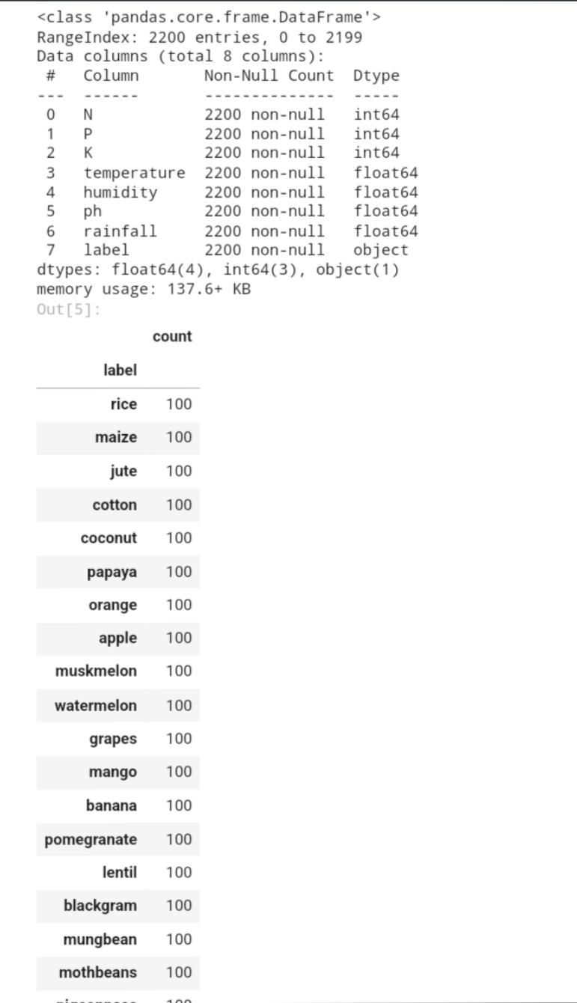
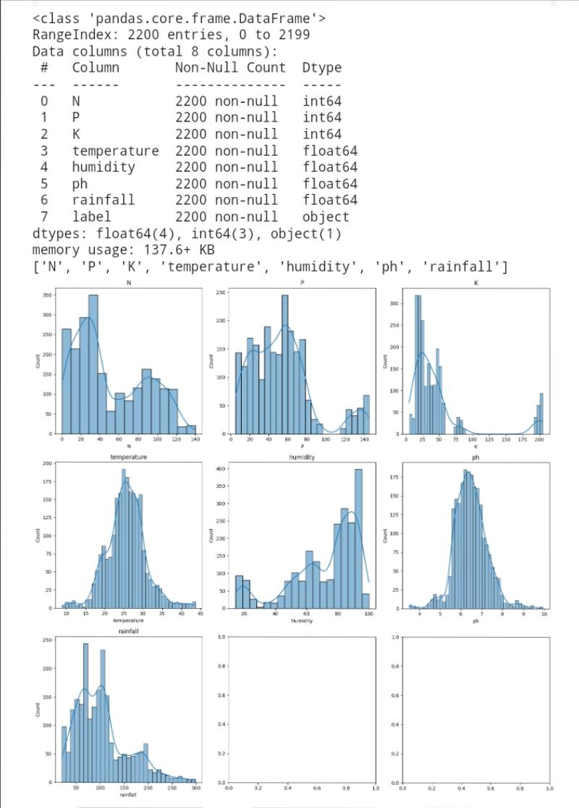
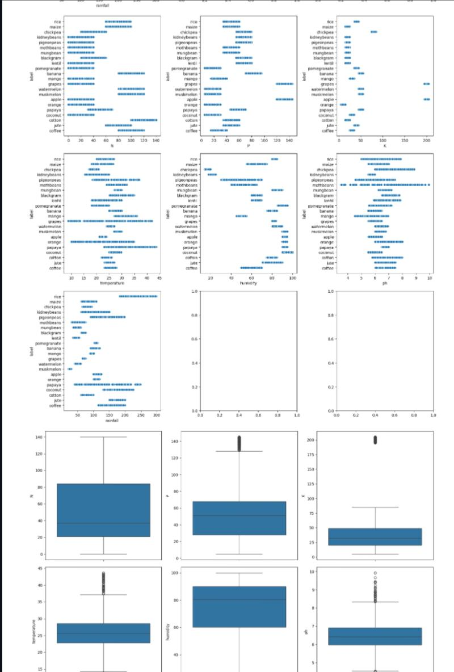
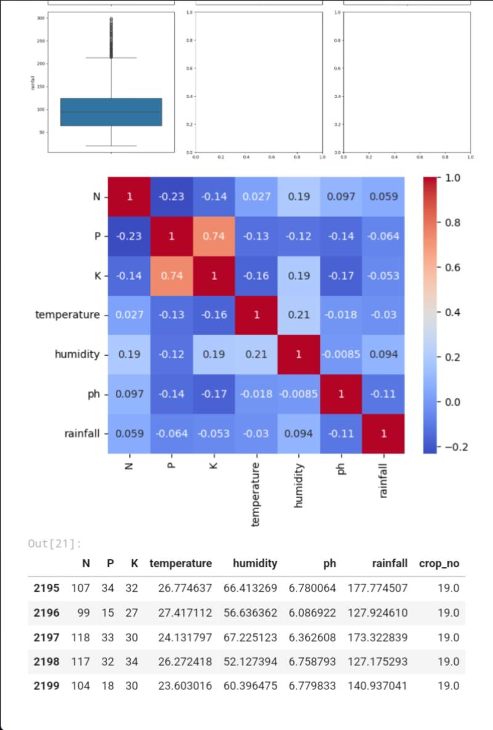
Screenshot of Output:

Slide 8
Conclusion:
●crop and fertilizer recommendation systems powered by machine learning represent a significant advancement in modern agriculture.
● By leveraging the power of data analysis and intelligent algorithms, these systems offer a multitude of benefits that contribute to increased efficiency, productivity, and sustainability in farming practices.
●crop and fertilizer recommendation systems using machine learning are playing a crucial role in transforming agriculture.
● By harnessing the power of data and intelligent algorithms, these systems are enabling farmers to make informed decisions, optimize resource utilization, and enhance productivity while promoting environmental sustainability.
● As technology continues to advance, these systems will play an even greater role in shaping the future of agriculture, ensuring food security and sustainable farming practices for generations to come.

